Slide 1
CSE 1322 Module 3 – Part 1
Inheritance

Slide 2
Relations
We can define certain relations between different classes.
Previously we have done “Composition” or “Aggregation” type relations.
For example, whenever a class contains another class as an attribute.
In this module, we will introduce the inheritance relation.

Slide 3
Unified Modeling Language
Whenever we work with complex OOP programs, we are going to end up dealing with lots of different types of classes.
These classes will interact and relate to one another with different types of relations.
The Unified Modeling Language allows us to draw and visualize these relations.

Slide 4
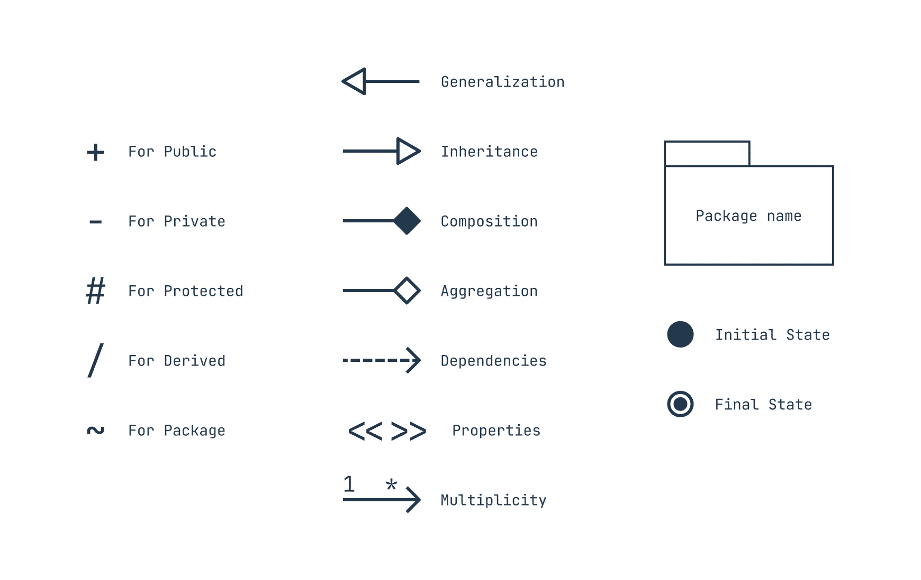
Unified Modeling Language
Furthermore, with UML we can also represent the different component and details of a class such as attributes and behaviors and each of their access modifiers.

Slide 5
Unified Modeling Language
Each class is drawn as a rectangle, with the class name at the top, followed by all the attributes, then all the methods.
We also specify their types or their return types.
Constructors are often not mentioned.

Slide 6
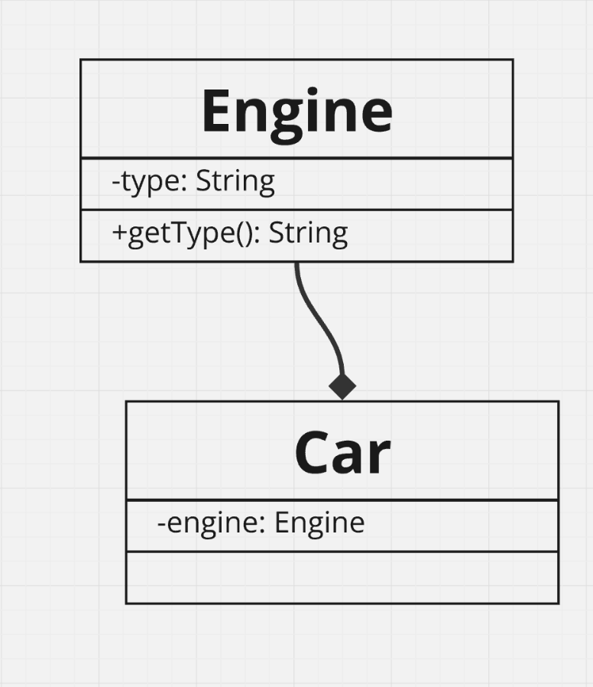
Unified Modeling Language
class Engine{
private String type;
public Engine(String type){
this.type = type;
}
public String getType(){
return type;
}
}
class Car{
private Engine engine;
public Car(String engineType){
this.engine = new Engine(engineType);
}
@Override
public String toString(){
return "This car has a " + engine.getType() + " type engine.";
}
}
Week-5/Composition.java

Slide 7
Unified Modeling Language
We are not going to cover in-depth this topic, but you are going to have to create or generate a UML diagram for you Lab Assignments and Labs.
Make sure you attend your Lab to learn mode details into this.

Slide 8
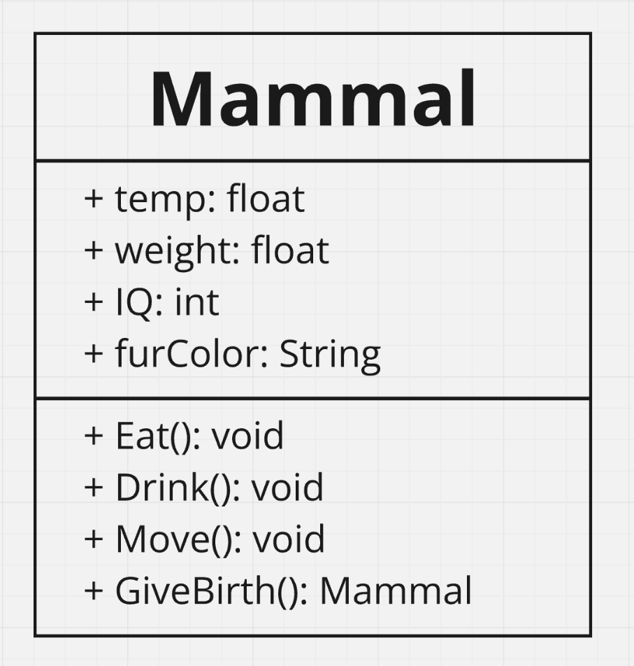
An Example – Mammal Class
Attributes
Temperature
Weight
Intelligence Level
Fur Color
Behaviors
Eat
Drink
Move
Give Birth

Slide 9
Inheritance
Inheritance allows a new class (child) to “inherit” an existing class’s (parent) members (attributes and behaviors).
Private members do get inherited at the object level but are not directly accessible in the child class, so make sure to use getters and setter functions from the parent class.
Inheritance allows us to re-use code!

Slide 10
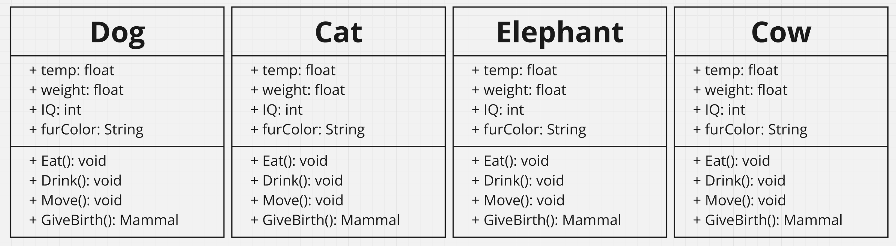
Inheritance
Let’s say that we want to expand our program and add Dogs, Cats, Elephants, Cows.
We could manually implement each:

Slide 11
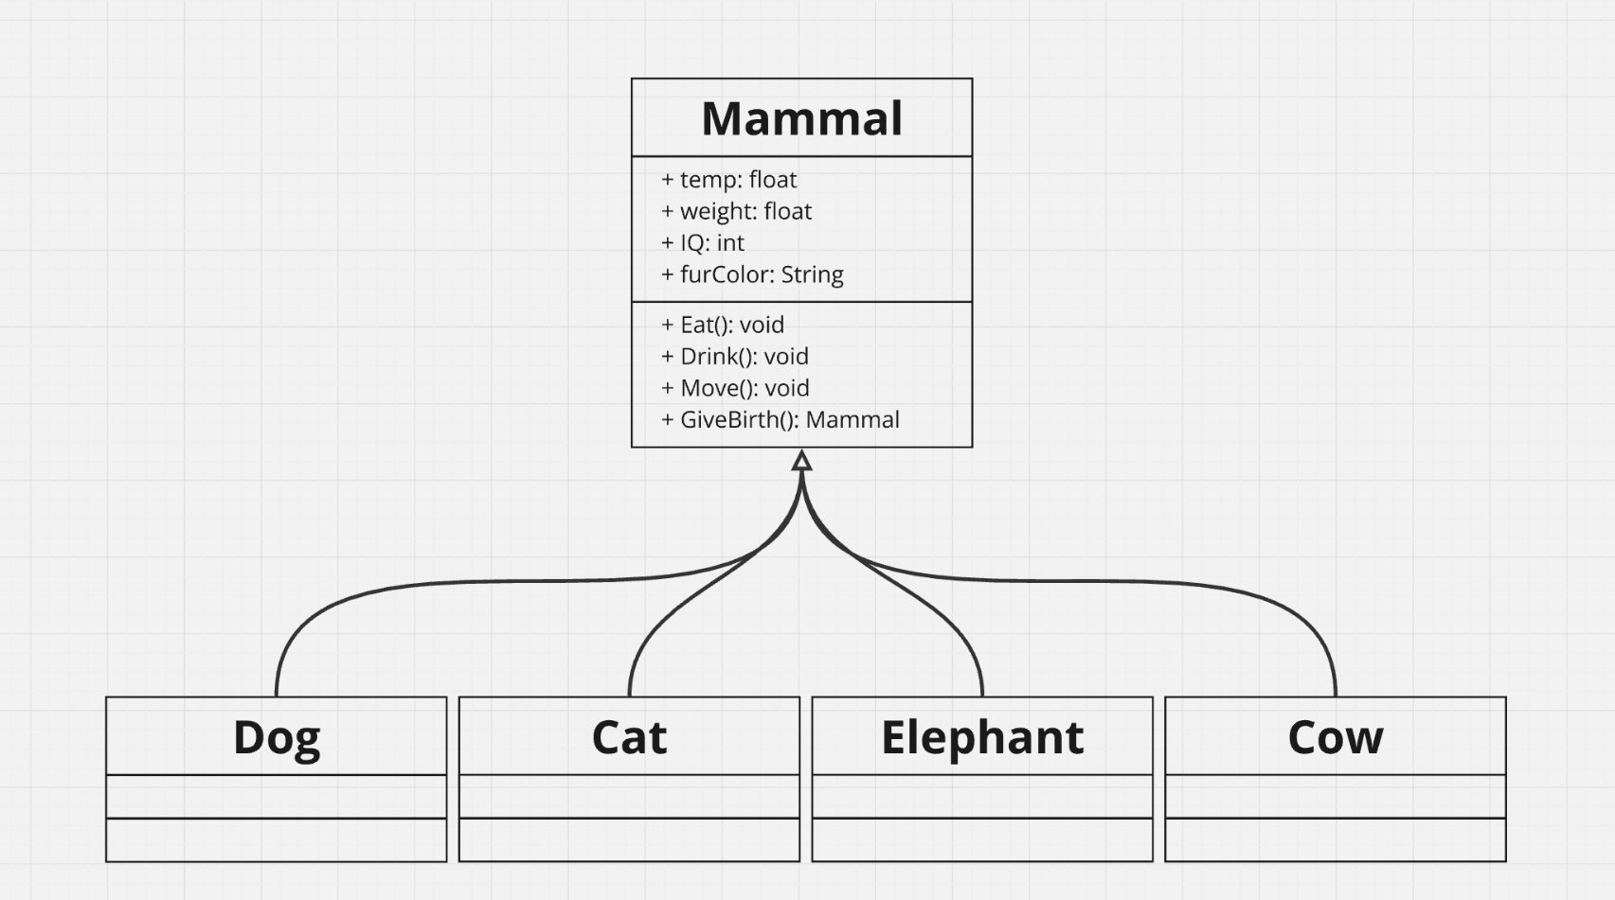
Inheritance
Or these animals could inherit the properties of Mammal:
We use the “white” arrow to show inheritance.

Slide 12
Inheritance
Through Inheritance, we can make all those different animal classes share a similar set of attributes and behaviors.
This means that we do not need to declare the weight attribute for the Dog class since it inherits this attribute from Mammal.

Slide 13
Inheritance
Now that the Dog, Cat, Elephant, and Cow classes share the same set of attributes, we can now develop each class with their own unique set of attributes and behaviors.
For example, Dogs could have a barkVolume integer attribute, Cats can have a likesToClimb Boolean attribute, Elephants could have a hasTusks Boolean attribute, and Cows could have a milkProduction integer attribute.

Slide 14
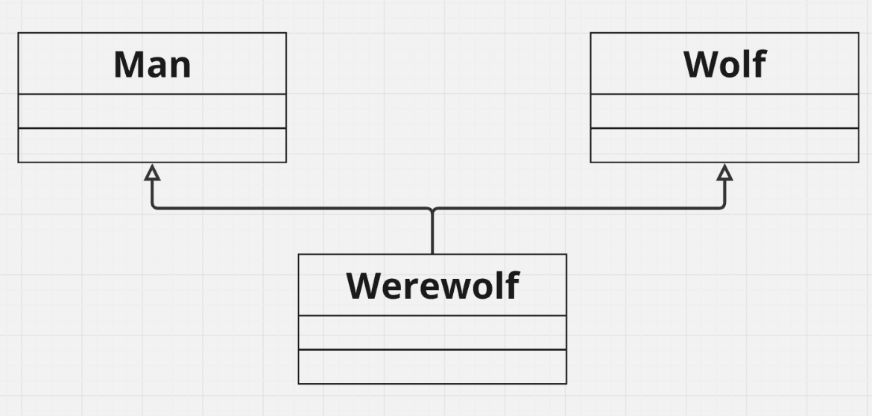
Inheritance – Multi-inheritance
One constraint with inheritance is that a child class can only inherit one parent class.
This is not valid:

Slide 15
Inheritance – Syntax
If a parent class is defined as:
class Mammal{
}

Slide 16
Inheritance – Syntax
Then the child classes can be defined as:
In short, we use the extends keyword.
class Dog extends Mammal{
}
class Elephant extends Mammal{
}
class Cat extends Mammal{
}
class Cow extends Mammal{
}

Slide 17
Inheritance – Mammal Class
class Mammal{
public float temp;
public float weight;
public int IQ;
public String furColor;
public Mammal(float temp, float weight, int IQ, String furColor){
this.temp = temp;
this.weight = weight;
this.IQ = IQ;
this.furColor = furColor;
}
public void Eat(){
System.out.println("This mammal is eating");
}
public void Drink(){
System.out.println("This mammal is drinking");
}
public void Move(){
System.out.println("This mammal is moving");
}
public Mammal GiveBirth(){
System.out.println("Mammal is giving birth to another mammal");
return new Mammal(30.4f, 300f, 1, "brown");
}
}
Week-5/Mammal/Driver.java

Slide 18
Inheritance – Dog Class
class Dog extends Mammal{
public int BarkVolume;
public void Bark(){
System.out.println("This dog is barking at " + BarkVolume + " dB.");
}
}
Week-5/Mammal/Driver.java

Slide 19
Inheritance – Dog Class
At this point, you may notice that your IDE is giving you an error:
Implicit super constructor Mammal() is undefined for default constructor. Must define an explicit constructor
This is because Mammal has an overloaded constructor, and since Dog inherits from it, we need to call the Mammal constructor inside the Dog class constructor.

Slide 20
Inheritance – super
Remember that we have a keyword to explicitly mention or reference the current object instance inside of the class
this() -> to reference the default constructor.
this.BarkVolume -> to reference the objects’s BarkVolume attribute.

Slide 21
Inheritance – super
We also have a way to explicitly mention or reference the current object’s parent class with the super keyword:
super() -> reference the parent’s default constructor
super.furColor -> reference the furColor attribute.

Slide 22
Inheritance – super
Going back to our issue, the error message mentioned that we must explicitly define the parent constructor:
public Dog(float temp, float weight, int IQ, String furColor, int BarkVolume){
super(temp, weight, IQ, furColor);
this.BarkVolume = BarkVolume;
}

Slide 23
Inheritance – Dog Class
class Dog extends Mammal{
public int BarkVolume;
public Dog(float temp, float weight, int IQ, String furColor, int BarkVolume){
super(temp, weight, IQ, furColor);
this.BarkVolume = BarkVolume;
}
public void Bark(){
System.out.println("This dog is barking at " + BarkVolume + " dB.");
}
}
Week-5/Mammal/Driver.java

Slide 24
Inheritance – Dog Class
Now we should be ready to create a Dog object and use it in our program.
public static void main(String[] args) {
// 38 celsius, 20 kg, 100 IQ, Brown Fur, 100dB bark
Dog d1 = new Dog(38f, 20, 100, "Brown", 100);
d1.Eat();
}

Slide 25
Inheritance – Dog Class
The output seems a bit wrong:
Let’s change that
public static void main(String[] args) {
// 38 celsius, 20 kg, 100 IQ, Brown Fur, 100dB bark
Dog d1 = new Dog(38f, 20, 100, "Brown", 100);
d1.Eat();
}
This mammal is eating

Slide 26
Inheritance – Overriding
As discussed previously, we can override functions or behaviors inherited.
To override a function, we must declare the same function header.
class Dog extends Mammal{
@Override
public void Eat(){
System.out.println("This dog is eating");
}
}

Slide 27
Inheritance – Overriding
class Mammal{
public void Eat(){
System.out.println("This mammal is eating");
}
}
class Dog extends Mammal{
@Override
public void Eat(){
System.out.println("This dog is eating");
}
}

Slide 28
Inheritance – Overriding
Remember that you can add the Override annotation @Override at the top of the overriding function.
This will help you ensure that you are overriding a function that you are inheriting
It also help ensure that you have defined the same function header to the function you are overriding.

Slide 29
Inheritance – Dog Class
class Dog extends Mammal{
public int BarkVolume;
public Dog(float temp, float weight, int IQ, String furColor, int BarkVolume){
super(temp, weight, IQ, furColor);
this.BarkVolume = BarkVolume;
}
public void Bark(){
System.out.println("This dog is barking at " + BarkVolume + " dB.");
}
@Override
public void Eat(){
System.out.println("This dog is eating");
}
}
Week-5/Mammal/Driver.java

Slide 30
Inheritance – Dog Class
Now the output will be more fitting:
public static void main(String[] args) {
// 38 celsius, 20 kg, 100 IQ, Brown Fur, 100dB bark
Dog d1 = new Dog(38f, 20, 100, "Brown", 100);
d1.Eat();
}
This dog is eating

Slide 31
Inheritance
We can also have more complex inheritance.
We could expand on what we have and add a parent class to the Mammal class, the Animal class.
We could also add a child class to Dog, the Labrador and Beagle Class.
We do not need to explicitly define “grand-parents”, this will be implied.

Slide 32
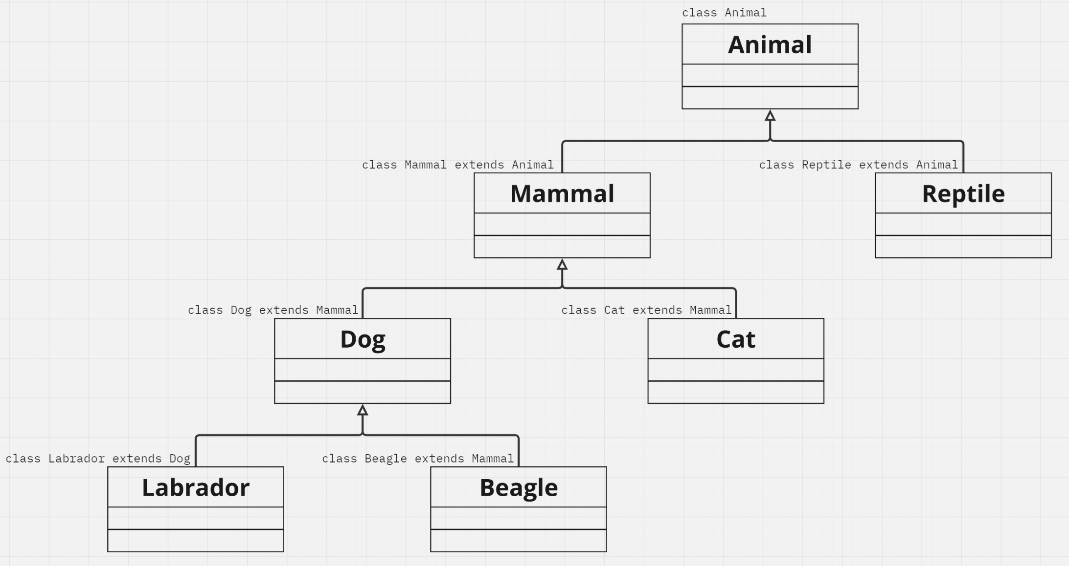
Inheritance

Slide 33
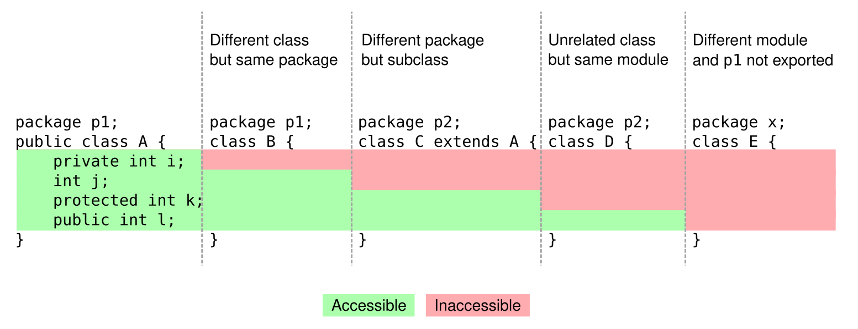
Access Modifiers

Slide 34
Inheritance – Object Class
All classes inherits from the Object Class (it is an actual built-in class called Object).
The Object Class has defined some useful functions such as the toString() function we discussed previously.

Slide 35
Inheritance – Object Class
Method | Description
clone​() | Creates and returns a copy of this object.
equals​(Object obj) | Indicates whether some other object is "equal to" this one.
getClass​() | Returns the runtime class of this Object.
hashCode​() | Returns a hash code value for the object.
notify​() | Wakes up a single thread that is waiting on this object's monitor.
notifyAll​() | Wakes up all threads that are waiting on this object's monitor.
toString​() | Returns a string representation of the object.
wait​() | Causes the current thread to wait until another thread invokes the notify() method or the notifyAll() method for this object.
wait​(long timeout) | Causes the current thread to wait until either another thread invokes the notify() method or the notifyAll() method for this object, or a specified amount of time has elapsed.
wait​(long timeout, int nanos) | Causes the current thread to wait until another thread invokes the notify() method or the notifyAll() method for this object, or some other thread interrupts the current thread, or a certain amount of real time has elapsed.

Slide 36
Inheritance – Object Class
We discussed that we cannot have multi-inheritance — a child class with more than one parent class.
Then how can the Dog class inherit from the Object class?

Slide 37
Inheritance – Object Class
Whenever we do not declare explicitly inheritance (using the extends keyword), Java by default extends the class to the Object class.
This is done “invisibly”:
class Mammal{
}
Even though we did not declare that Mammal inherits from Object, Java will implicitly do that for us, so we do not have to do this every single time.
class Mammal extends Object{
}

Slide 38
Inheritance – Object Class
Now, since Dog inherits or extends the Mammal class then the Dog class will also inherit the functions from the Object class.
class Dog extends Mammal{
@Override
public String toString(){
return "This is a Dog object";
}
}

